Slide 1

U.S. Air BNB Exploratory data analysis
with machine modelling

Slide 2
Source and Problem Statement
https://www.kaggle.com/kritikseth/us-airbnb-open-data
Since its inception in 2008, Airbnb has disrupted the traditional hospitality industry as more travellers decide to use Airbnb as their primary means of accommodation. Airbnb offers travellers a more unique and personalized way of accommodation and experience.
Content
This dataset has one file- AB_US_2020.csv which has columns describing features such as host id, hostname, listing id, listing name, latitude and longitude of listing, the neighbourhood, price, room type, minimum number of nights, number of reviews, last review date, reviews per month, availability, host listings and city.

Slide 3
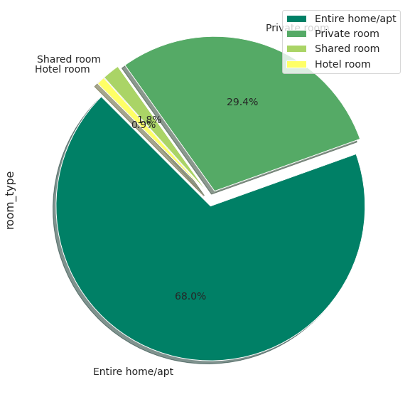
Listing Preferred Mostly

Slide 4
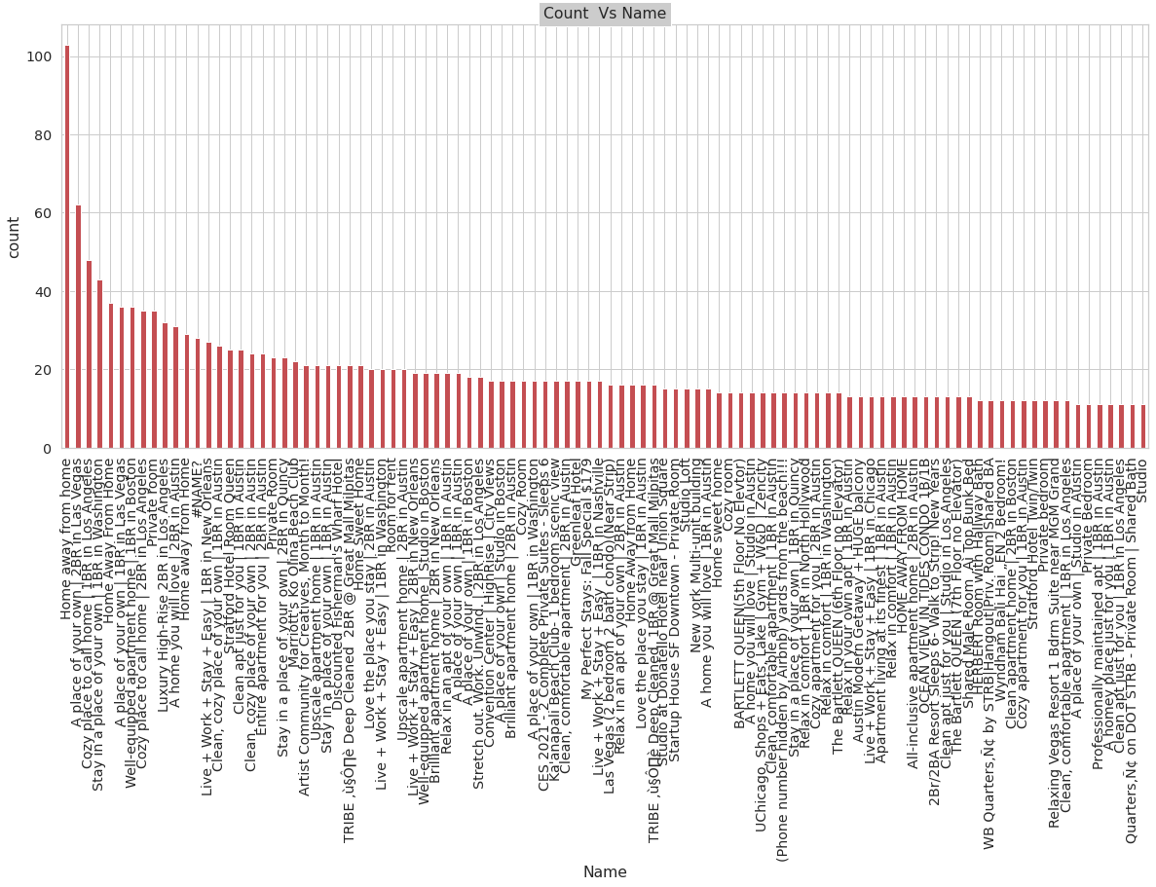
Name of Listing :-

Slide 5
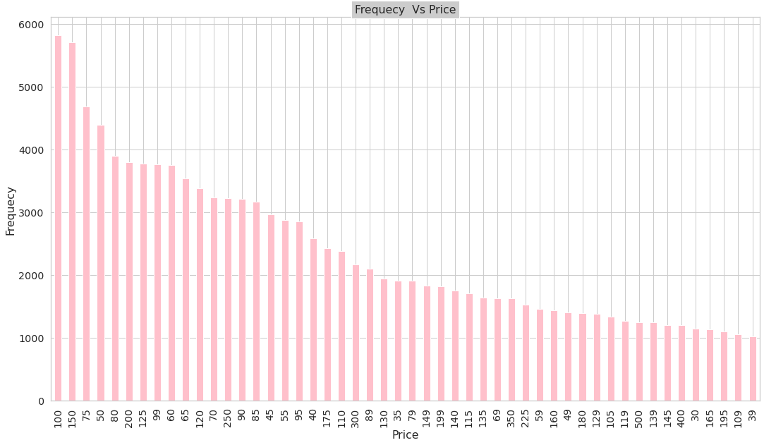
Price Of Listing:-

Slide 6
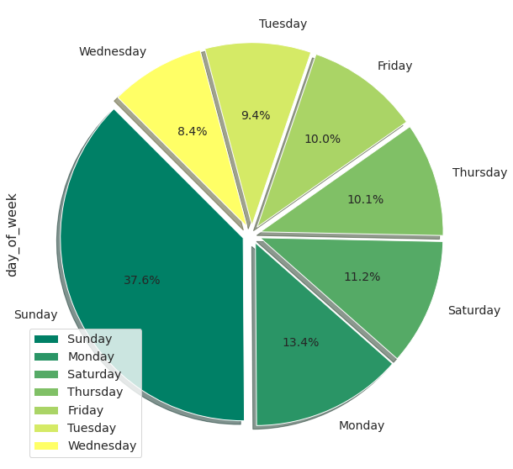
Day of week Listing booked for:-

Slide 7
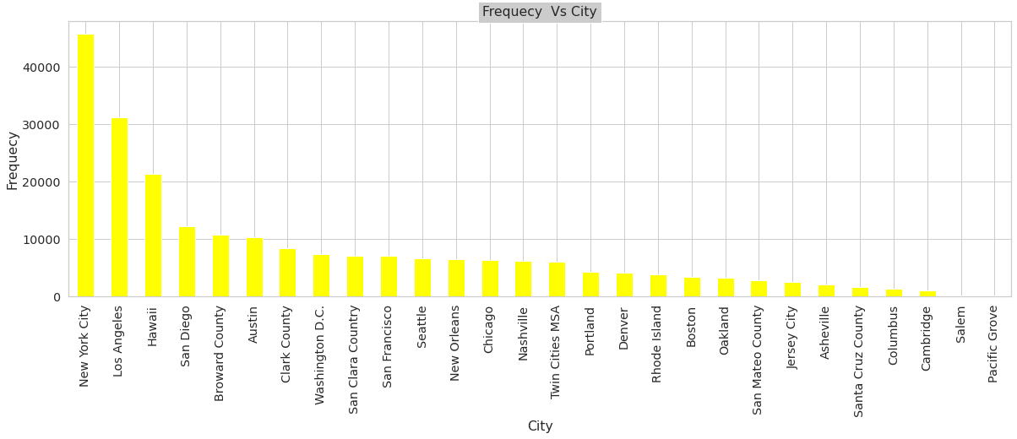
Highest Listing City Wise:-

Slide 8
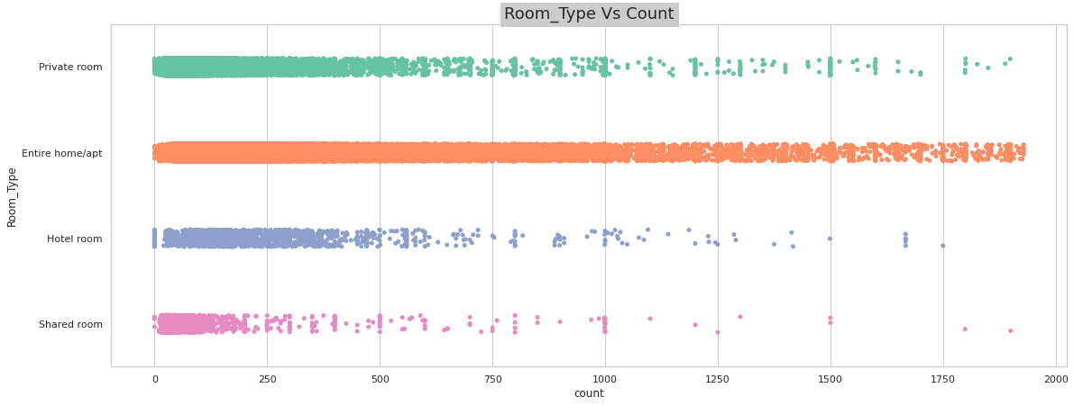
Price Vs. Listing Type

Slide 9
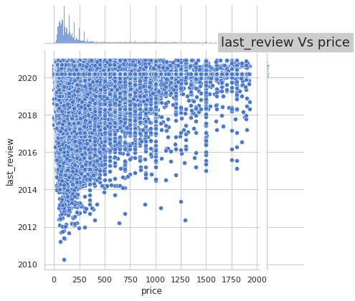
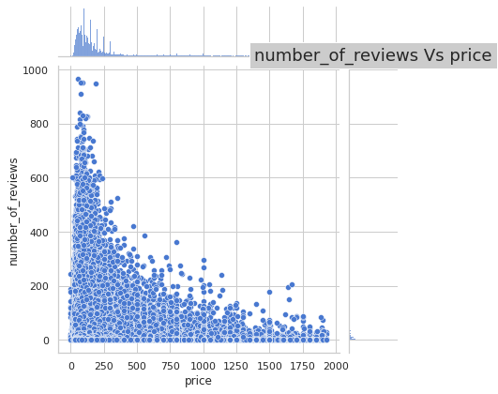
Comparison with Price
Last review Vs. Price
Number_of_reviews Vs. Price

Slide 10
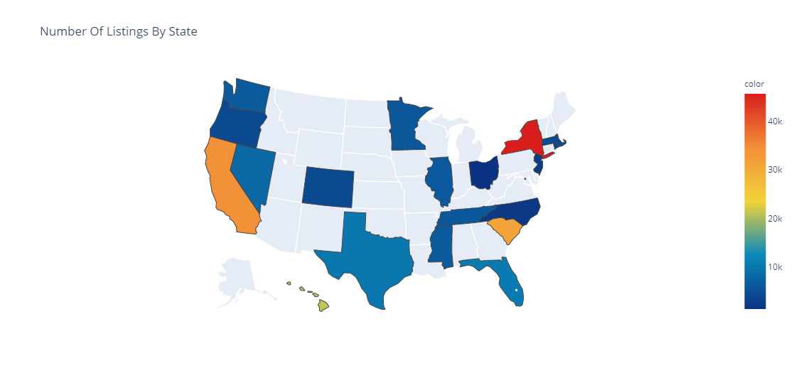
Number Of Listings By State
Top two Listing By state | Bottom Two Listing By state
1.New York City | 1.Columbus
2.San Francisco | 2.Asheville

Slide 11
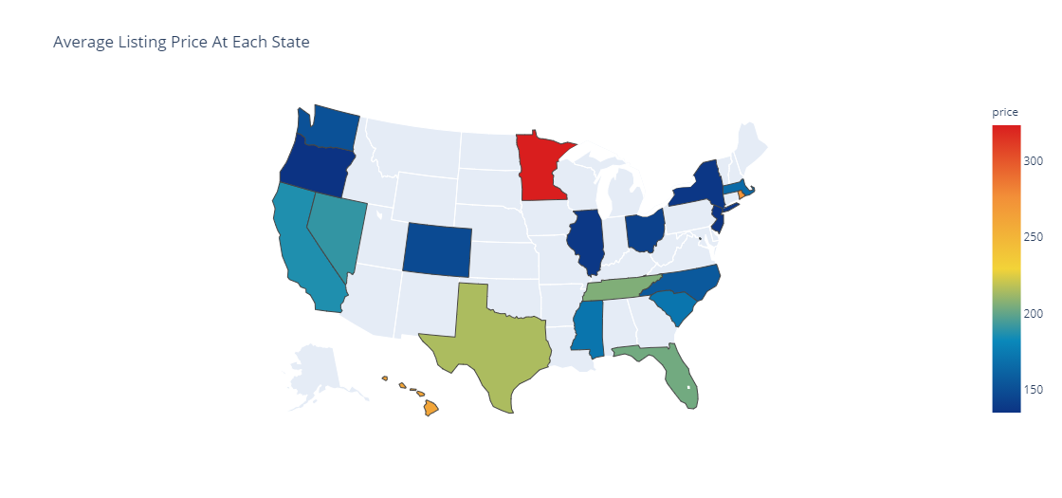
Average Listing Price At Each State
Top two Listing price in each state | Bottom Two Listing price in each state
1.Twin Cities MSA | 1.Jersey City
2.Hawaii | 2.New York City

Slide 12
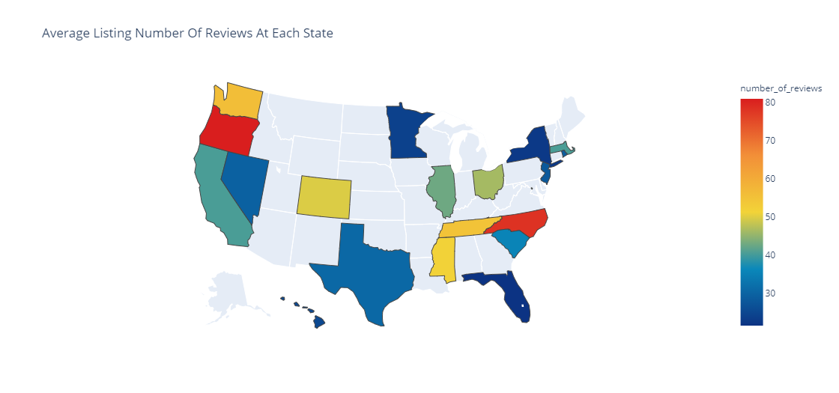
Average Listing Number Of Reviews At Each State
Top two Number of Reviews in each state | Bottom Two Number of reviews in each state
1. Portland | 1.Broward County
2. Asheville | 2.New York City

Slide 13
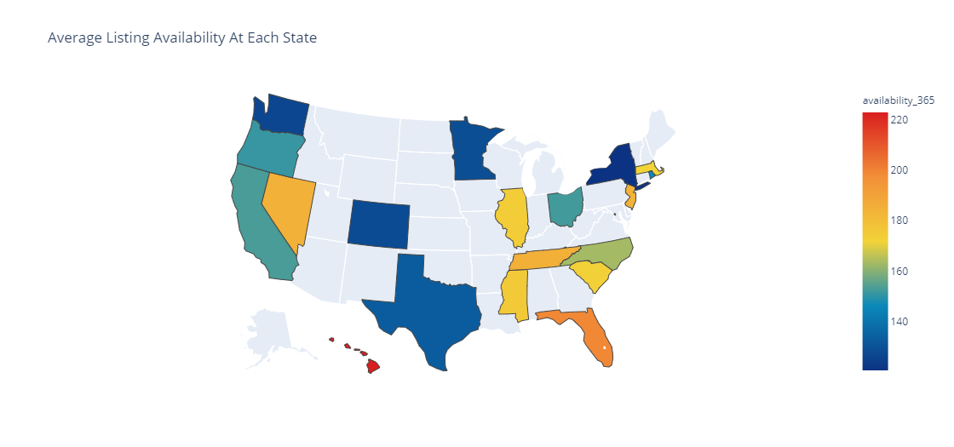
Average Listing Availability At Each State

Slide 14
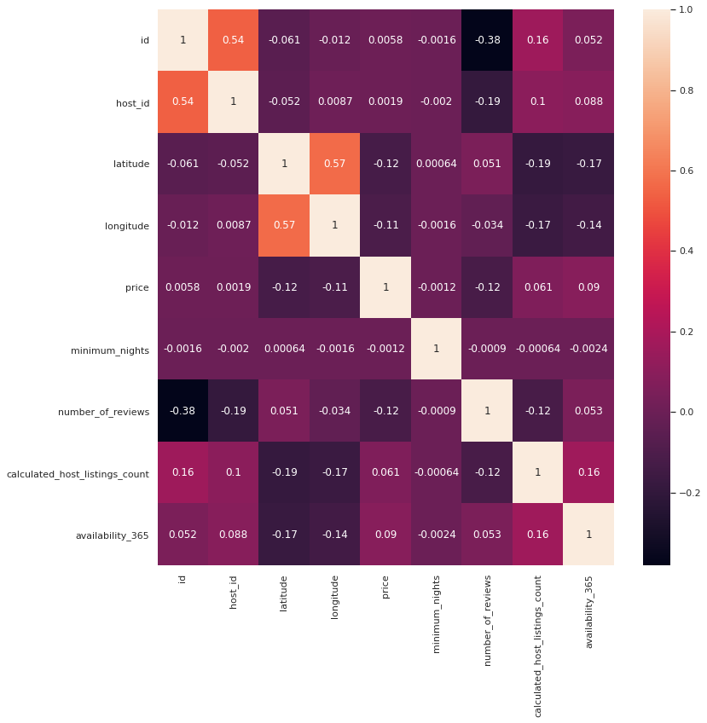
Correlation

Slide 15
Observations:-
We have 5 Listing which has Highest Price as 1930 and we have some Listing with price as 0 too .And the maximum Price which has highest frequency is 100
We have most of the Listing where room type is as Entire Home/Apt and 1897 listing as Hotel Room
Most of the Reviews we have got is on Sunday and we can also say that people mostly Travel on weekends.
New York is the city with Highest Price of Listing and Salem as lowest listing .
We have 56773 Listing which are not available for even a 0 day followed by Listing which are available for 365 Days and same is the Price Highest for Listings which are available for 0 day.
We have 0 Listing available which is available whole year.
Average Listing Price is Highest in city Twin Cities MSA followed by Hawaii
Average Listing Number Of Reviews is highest in Portland city followed by Asheville

Slide 16
Actionable Insights
We can increase price by providing some additional facilities may be in the form of some discount coupons and some refreshment .
The one which are highly priced should provide some pick up facilities from same city or from same city airport to get more reviews .
They should reward their customer which small gift yearly which will encourage them to come to their listing more.

Slide 17
Machine Models
Linear Regression
Decision Tree Regressor
RandomForestRegressor
MAE for training set is 0.6192
MAE for test set is 0.619681
MSE for training set is 0.8165
MSE for test set is 0.8240175
RMSE for training set is 0.903
RMSE for test set is 0.907754
ADJ R^2 VALUE: 0.1781950
MAE for training set is 0.6200987
MAE for test set is 0.61619720
MSE for training set is 0.81718084
MSE for test set is 0.8214752
RMSE for training set is 0.903980
RMSE for test set is 0.90635272
Adj R^2 value: 0.1822
MAE for training set is 0.62
MAE for test set is 0.616
MSE for training set is 0.81
MSE for test set is 0.82147
RMSE for training set is 0.90
RMSE for test set is 0.906
Adj R^2 value: 0.1822992

Slide 18
Results:-
All models have same RMSE value but adjusted R squared value is same for both Decision Tree and Random Forest.

Slide 19


